Slide 1

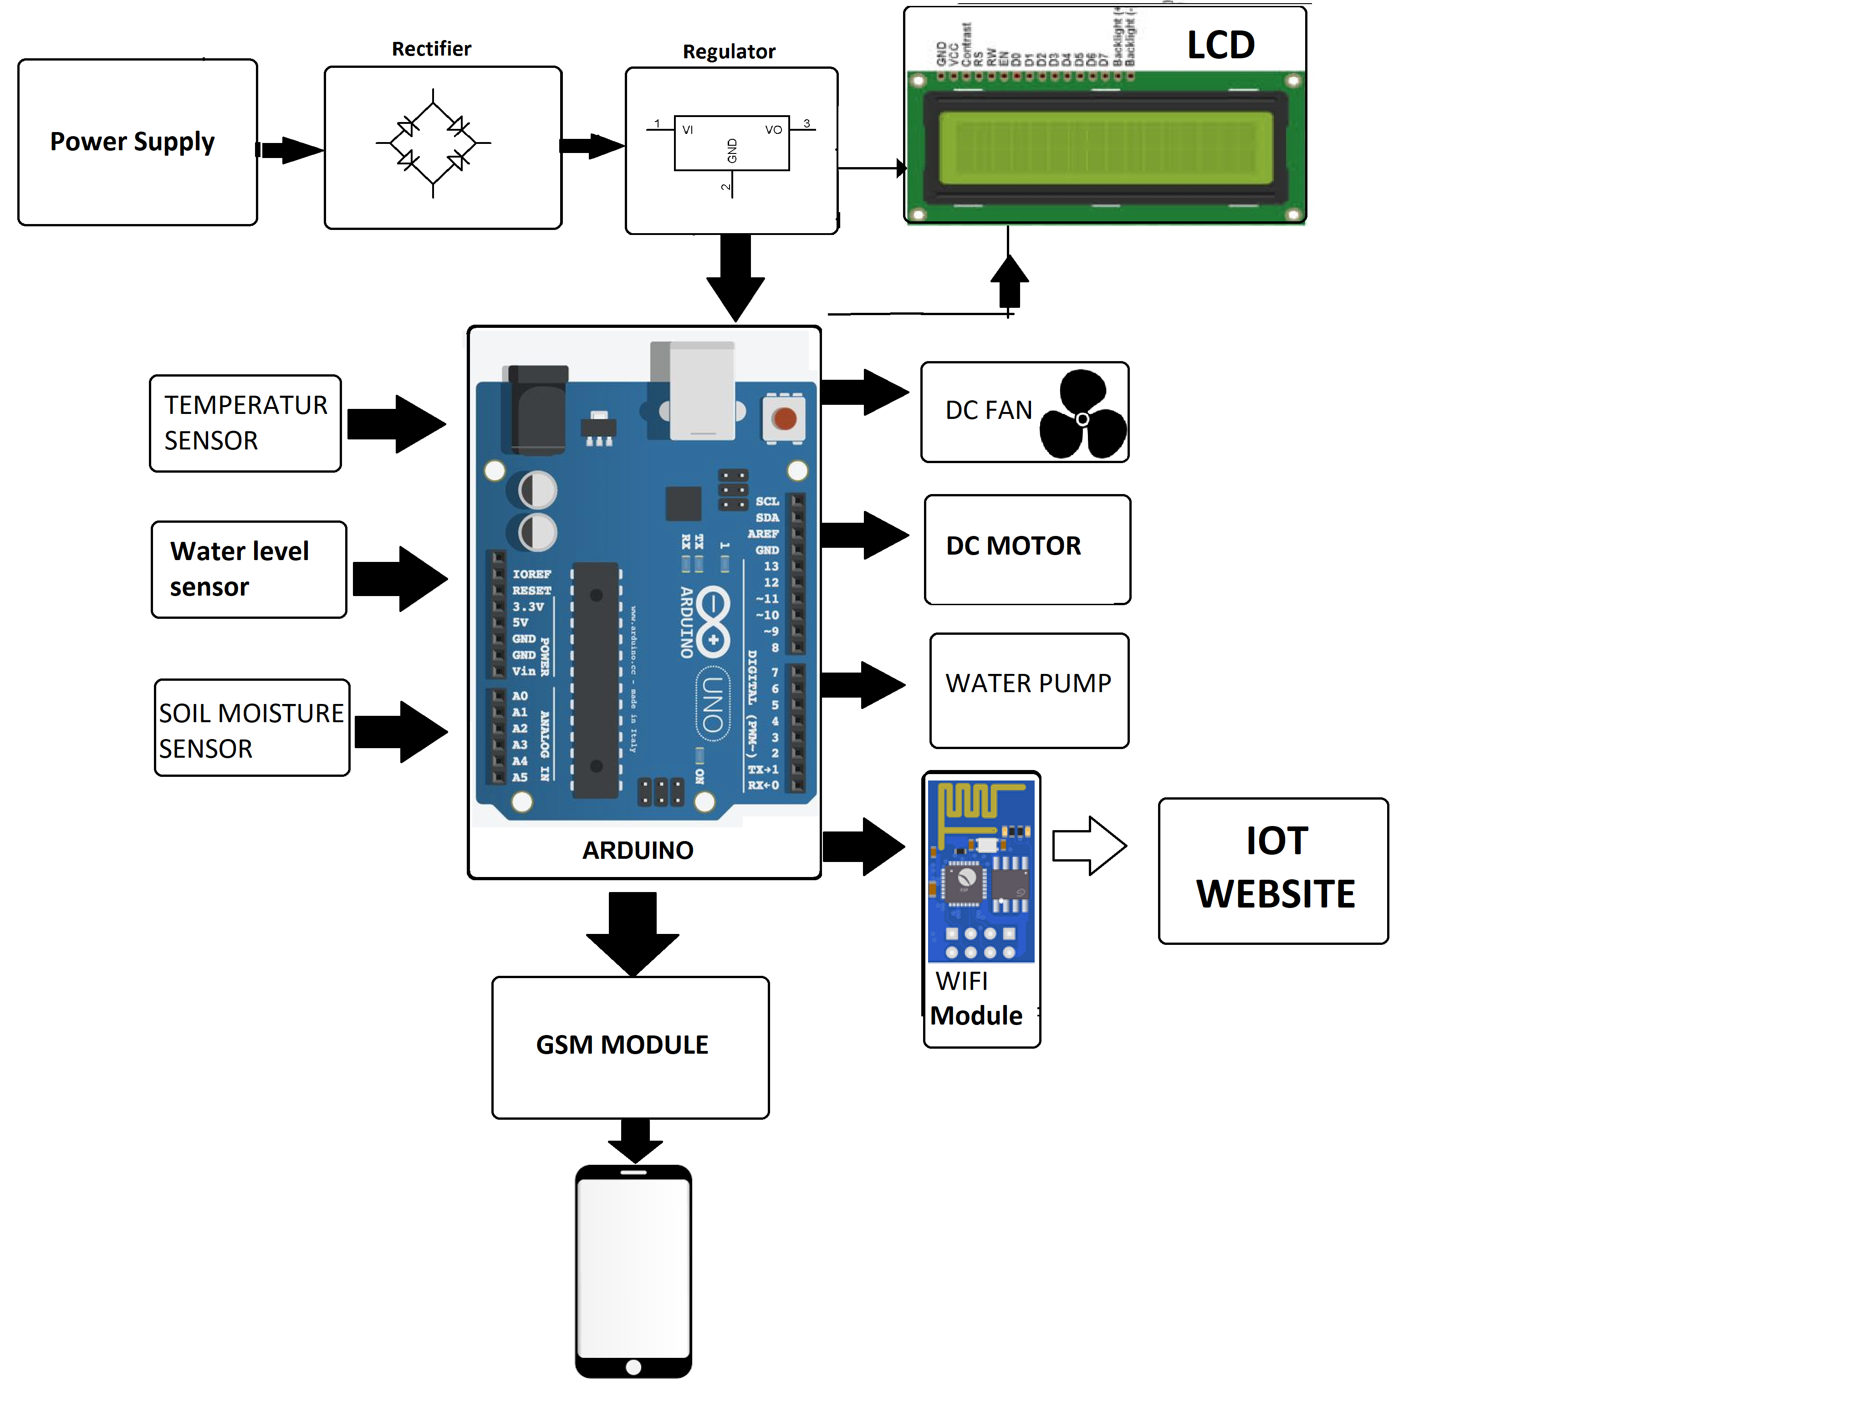
Smart Agriculture System Using IoT
Faculty Guide:
Prof. Sagar Tambe
Abstract/ Project Insights:
The Internet of Things (IoT) is a typical example that is rapidly growing in the world of modern wireless telecommunication. It refers to a wireless network between objects. Internet of Things refers to the concept that the Internet is no longer just a global network for people to communicate with one another using computers, but it is also a platform for devices to communicate electronically with the world around them. Agriculture is the main occupation in India. India's two-third of population is directly or indirectly dependent on agriculture. Agriculture's performance has a substantial impact on the economy of our country. The agricultural productivity may be harmed mainly because of the problems like unplanned irrigation, intruder attacks. In agriculture, irrigation system plays an important role in getting the good yield. Traditional method of irrigation system is done manually which causes wastage of water. Crops may also be destroyed by the predators' attack which leads to production loss. The solution to this problem is making agriculture smart by using automation and IoT technologies. Hence this project aims at modernizing the current traditional methods of agriculture by making use of smart irrigation system by taking intelligent decisions based on the accurate field data. The intruders' problem can be overcome by monitoring the field and threatening the intruder. These can be made happened by using various sensors, GSM modem, Wi-Fi with microcontrollers .
Proposed Method
Future Scope:
Future work would be focused more on increasing sensors on this system to fetch more data especially with regard to and by also integrating GPS module in this system to enhance this Agriculture IoT Technology to full-fledged Agriculture Precision ready product.
AKSHAY SANGHANI
PRAGATI SATPUTE
RISHABH PATHAK
SAYALI LIGADE

